Slide 1
Integrative Machine learning approach for Stock price prediction with Apple Inc. and S&P500 datasets
Poojith Sonti (02080247)

Slide 2
Introduction
This project aims to develop a robust predictive model using the historical stock data of Apple Inc. and S&P 500, focusing on daily trading metrics like open, close, high, low prices, and volume. The model’s goal is to analyze trends and patterns to accurately forecast future stock prices. The significance of this project lies in its ability to transform raw financial data into actionable insights, which is crucial for the high-stakes environment of stock trading. Accurate predictions can lead to substantial economic gains, effective portfolio management, and strategic financial planning, thereby contributing to the financial industry's stability.
By employing a variety of machine learning techniques and a detailed dataset, this project focuses on understanding the stock price dynamics of the tech industry. It introduces innovative data preprocessing and feature engineering to enhance model performance. Comprehensive documentation and open-source sharing of the methodology encourage further academic and practical exploration.

Slide 3
Aim of the project
The primary goal of this project is to harness the capabilities of machine learning to predict the stock prices of Apple Inc. (AAPL) using historical trading data. By implementing advanced algorithmic strategies and utilizing a comprehensive dataset including daily open, close, high, low, and volume metrics, the project seeks to develop a predictive model that forecasts future prices with high accuracy. This endeavor aims not only to provide actionable insights for investors but also to contribute to the broader academic and practical understanding of financial market dynamics.

Slide 4
Methodology
Historical trading data for Apple Inc. and S&P 500 from a comprehensive dataset including daily open, high, low, close, and volume metrics.
Preprocessing: Data cleaning, handling missing values, and transformations to ensure consistency and accuracy.
Selection: Identifying and isolating significant features like close prices to predict future values.
Normalization: Utilizing MinMaxScaler to scale features, ensuring uniform input for model training.
Algorithms: Implementation of diverse models including Linear Regression, ANN, CNN, and LSTM to capture various stock price behaviors.
Training: Models are trained on prepared datasets, optimizing parameters to improve predictive performance.
Metrics: Use of R² score and Mean Squared Error (MSE) for assessing model accuracy.
Visualization: Comparison of predicted versus actual stock prices through graphical representations to evaluate model effectiveness.
Predictive Tool Development: Creation of a tool that assists investors in decision-making by forecasting stock price movements.

Slide 5
Techniques
1. Linear Regression : A statistical method that predicts future prices by establishing a linear relationship between independent variables (like past stock prices) and the dependent variable. Functionality: It calculates coefficients to minimize prediction errors, creating a line of best fit for future price forecasts. Importance: Serves as a baseline model due to its simplicity and efficiency, fundamental for initial analyses and comparisons.
2. Convolutional Neural Network (CNN): Originally designed for image processing, CNNs are applied to sequential stock data, treating price movements as image-like structures for pattern recognition. Functionality: Uses convolutional layers to detect features and temporal dependencies automatically, essential for capturing local patterns in data. Importance: Critical for recognizing patterns in time-series data like trends and cycles, which may be overlooked by other models. Slide 2: Advanced Neural Network Models

Slide 6
3. Artificial Neural Network (ANN) Description: Networks of neurons that simulate the way a human brain operates, capable of learning complex patterns in data. Functionality: Processes inputs through multiple layers, making it highly effective for non-linear relationship modeling. Importance: Indispensable for capturing the intricate dynamics of stock markets due to its ability to model complex and non-linear interactions.
4. Long Short-Term Memory (LSTM) Description: A type of RNN specialized in learning long-term dependencies, LSTMs can remember information for extended periods, ideal for data with long temporal sequences. Functionality: Avoids the vanishing gradient problem common in traditional RNNs, making it suited for predicting future stock prices based on past data. Importance: Particularly effective in volatile markets where past events significantly influence future trends.
5. Random Forest Regressor Description: An ensemble method that uses multiple decision trees to make predictions, improving accuracy and controlling over-fitting. Functionality: Builds several decision trees on different data samples and averages their predictions to enhance reliability. Importance: Excellent for handling complex datasets with interactions between variables, providing robustness against overfitting.

Slide 7
Results
A heatmap displaying the correlation coefficients among different trading metrics such as open, close, high, low, and volume for AAPL stock. High correlation coefficients (close to 1) among the open, close, high, and low prices suggest strong linear relationships, essential for feature selection in predictive modeling. The volume shows weaker correlations, indicating less direct impact on price movements.
Linear regression model: A plot comparing the actual stock prices with those predicted by a Linear Regression model over time. The model achieved a high R² score of 0.9931, indicating excellent predictive accuracy. The plot shows the predicted values (red line) closely following the actual stock values (blue line), though some divergences suggest areas for model improvement. The close fit suggests strong linear predictability in the data, with potential overfitting risks needing further investigation.
ANN model: This value is very close to 1, indicating that the ANN model explains approximately 98.8% of the variance in the stock prices from the dataset. This is a high score and suggests that the model has a strong predictive performance.

Slide 8
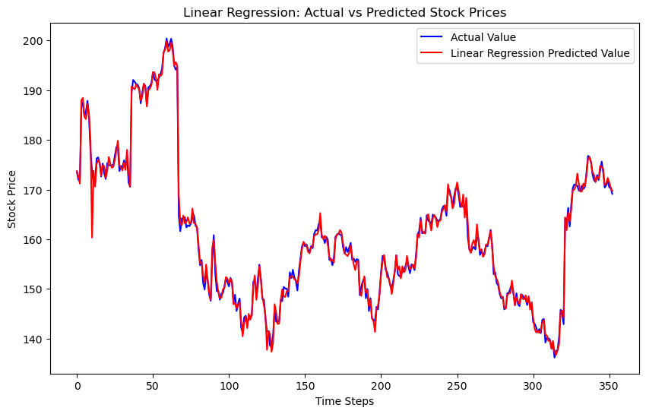
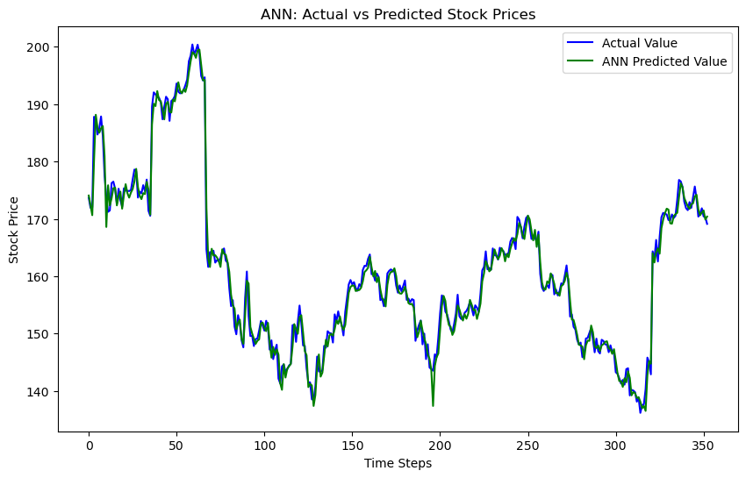

Slide 9
CNN model: The R2 score for the CNN model is 0.9878283769495727. This score is a statistical measure that represents the proportion of the variance for a dependent variable that's explained by an independent variable or variables in a regression model. An R2 score close to 1 indicates that the model explains a large portion of the variance in the response variable. An R2 score of approximately 0.988 suggests that the CNN model captures about 98.8% of the variance in stock prices, highlighting its effectiveness in modeling and predicting stock price movements.
After the data transformation we perform with some more models.
LSTM model: : The R2 score is 0.9333625. The LSTM's ability to remember information over long periods is highly beneficial in this context, allowing it to achieve a high R2 score, suggesting that it can predict stock prices with high accuracy.
ANN model: The R2 score is 0.920894. The ANN model performs slightly worse than the LSTM but still shows a robust ability to predict stock prices, as reflected in its R2 score. This suggests that while it can model non-linear relationships well, it lacks the sequential memory capability of LSTMs.
CNN model: CNN Time Series R2 score: 0.9133435550008135. The CNN model, typically used for spatial data, provides a reasonable prediction of stock prices. However, its R2 score is slightly lower than the LSTM and ANN, indicating that while useful, it may not fully capture the temporal dependencies as effectively as models specifically designed for time series analysis.

Slide 10
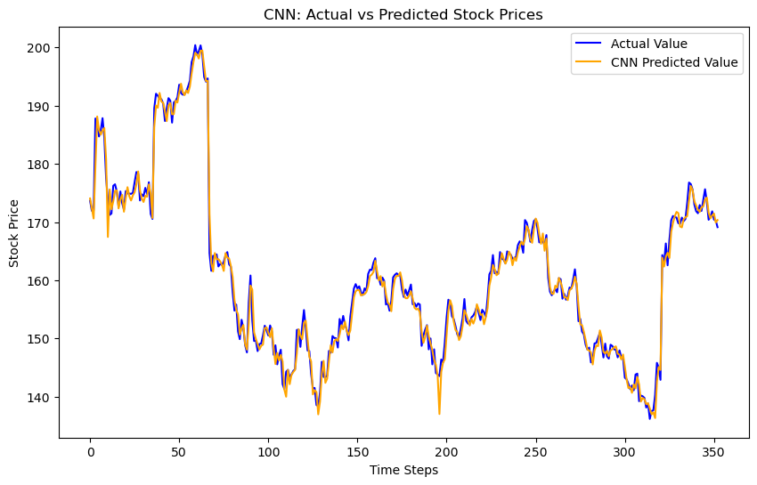
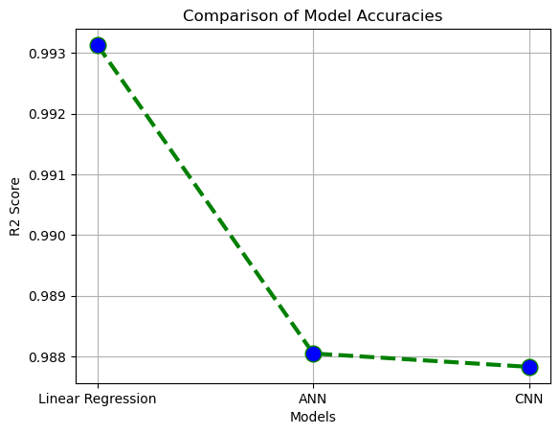

Slide 11
In the second part of the project I have used a particular dataset that is taken from yahoo datasets of the company Apple Inc. This dataset consists of the data of stock prices of Apple company from 2023 may to 2024 april.
The image depicts the historical closing prices of Apple stock over a span of approximately 251 days. The y-axis shows the stock price in USD, and the x-axis represents the day count starting from zero. The plot provides a visual representation of the stock's performance over time, showing trends such as increases or decreases in value. This visualization helps in analyzing the stock’s behavior for further financial analysis or predictive modeling.
The graph shows the predictions made by a Random Forest model on the same stock prices, depicted with dashed lines diverging from the actual prices near the end of the series. A Random Forest Regressor is used here, which is a robust machine learning model for regression tasks:
Similar to LSTM, the features might be scaled, although it's not necessary for tree-based models.
This involves initializing a RandomForestRegressor with parameters like the number of estimators.
The model is trained on historical price data and used to forecast future prices.
Predicted values are plotted against actual stock prices to evaluate the model’s predictive performance.

Slide 12
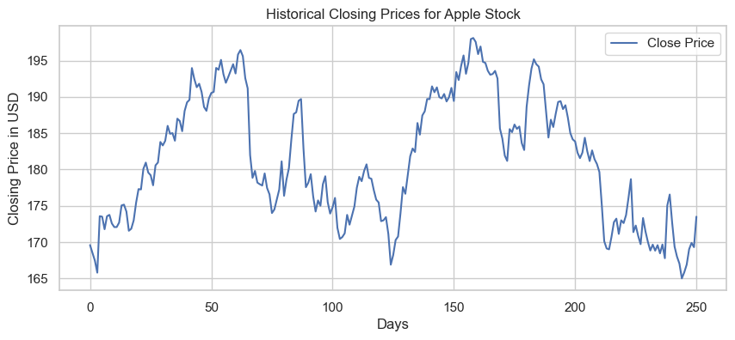
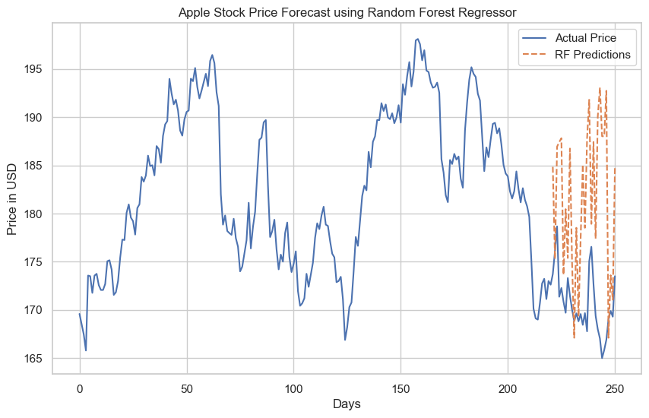

Slide 13
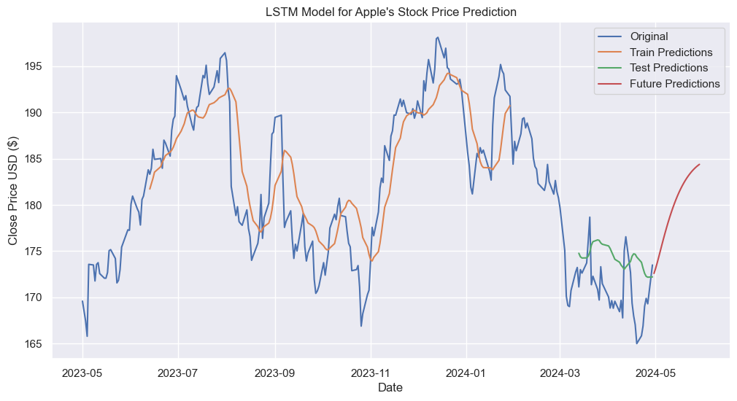
The data is first scaled using MinMaxScaler to normalize the input features to the range [0,1].
A dataset creation function create_dataset is utilized to generate input sequences for the LSTM model from the time series data.
• The LSTM model is constructed using the Sequential model from Keras, incorporating LSTM layers for learning the sequential dependencies and Dense layers for outputting the prediction.
• The model is trained using historical data, where the input is the past 'n' stock prices (determined by look_back) and the target is the next day's price.
The graph indicates that the LSTM model has a good fit on both the training and testing data, as evidenced by the close alignment between the model's predictions and the actual values. The future predictions provide a speculative trajectory of the stock price, useful for planning and risk assessment in financial activities.

Slide 14
Limitations
Data Quality and Completeness:
The reliability of predictive insights heavily depends on the accuracy and completeness of the data. Missing data points or errors in data collection can significantly impact model outcomes.
Historical Data Limitations:
Predictive models primarily rely on historical data, which may not always be indicative of future trends, especially during periods of high market volatility or economic upheaval.
Scope of Data:
The analysis might be limited to specific stocks or time frames, reducing the generalizability of the findings to other sectors or broader market indices.
Modeling Assumptions:
All predictive models operate under certain assumptions, which might not hold under all market conditions. This can limit the model's ability to generalize and predict future trends accurately.
Financial Market Complexity:
Stock prices are influenced by numerous factors including economic indicators, company performance, political events, and market sentiment. Simplifying these complex interactions in a model can lead to significant inaccuracies.

Slide 15
Conclusion
Project Summary: Developed a robust model leveraging machine learning to predict Apple Inc.'s stock prices, using historical data to analyze and forecast future market behaviors effectively.
Key Achievements:
Accuracy: Achieved high predictive accuracy with models like Linear Regression, ANN, LSTM, and CNN, demonstrating strong capability in capturing stock price trends.
Insights: Provided valuable insights into the dynamics of stock prices, enhancing investment strategies and risk management.
Academic and Practical Impact:
Financial Sector: Offers tools that improve the accuracy of portfolio forecasts and investment strategies, directly enhancing profitability.
Educational Contributions: Serves as a practical case study for applying advanced machine learning techniques in real-world financial scenarios.

Slide 16
Future Work
Advanced Model Integration:
Explore Hybrid Models: Combine features of different models (e.g., LSTM with CNN) to capture both temporal dependencies and spatial features more effectively.
Incorporate Reinforcement Learning: Utilize reinforcement learning techniques to adaptively refine trading strategies based on market behavior.
Data Enrichment:
Real-Time Data Feeds: Implement real-time data processing to react promptly to market changes.
Alternative Data Sources: Integrate sentiment analysis from social media and news sources to gauge market sentiment and its impact on stock prices.
Robustness and Scalability:
Stress Testing Models: Conduct rigorous stress tests under various economic scenarios to ensure robustness.
Scalability Improvements: Optimize computational efficiency to scale the models for processing larger datasets across more stocks.

Slide 17
THANK YOU

